Slide 1
Numerical Methods
Atifa Kanwal
atifa.kanwal@seecs.edu.pk
Office # 303, Faculty Block, SEECS, NUST

Slide 2

Interpolation

Slide 3
Newton’s Divided Difference Interpolation Formula
Applicable to equally spaced data as well as unequal spaced data.
To develop the formula, first we have to study Divided Differences.

Slide 4
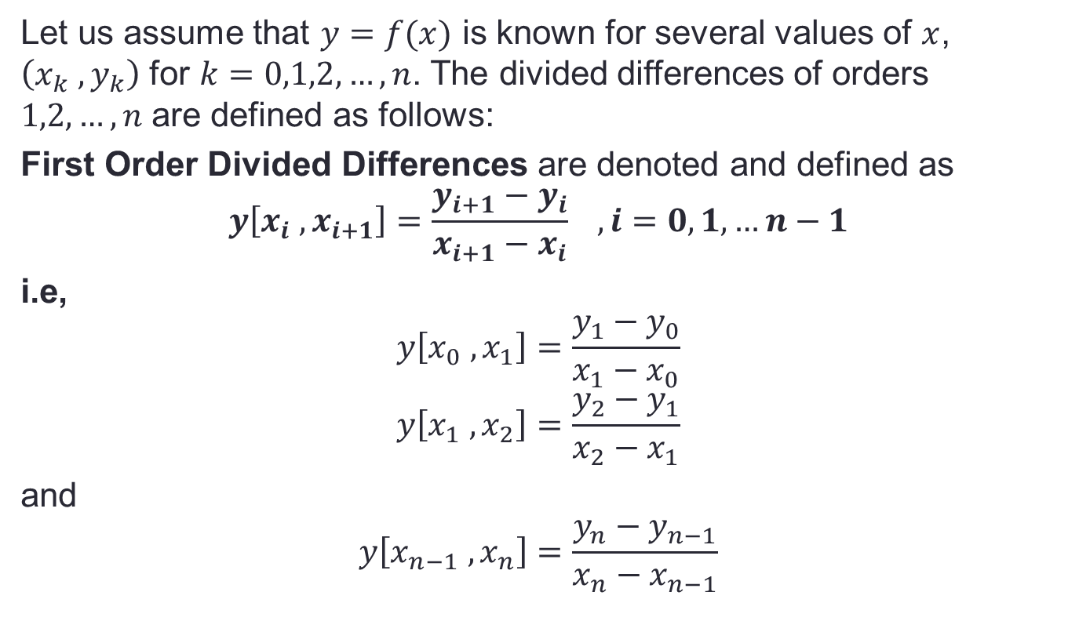
Divided Differences
Let us assume that $y=f(x)$ is known for several values of $x$, $\left(x_{k} ,y_{k}\right)$ for $k=0,1,2,…,n$. The divided differences of orders $1,2,…,n$ are defined as follows:
First Order Divided Differences are denoted and defined as
$$y\left[x_{i} ,x_{i+1}\right]=\frac{y_{i+1}−y_{i}}{x_{i+1}−x_{i}} ,i=0,1,…n−1$$
i.e,
$$y\left[x_{0} ,x_{1}\right]=\frac{y_{1}−y_{0}}{x_{1}−x_{0}}$$
$$y\left[x_{1} ,x_{2}\right]=\frac{y_{2}−y_{1}}{x_{2}−x_{1}}$$
and
$$y\left[x_{n−1} ,x_{n}\right]=\frac{y_{n}−y_{n−1}}{x_{n}−x_{n−1}}$$

Slide 5
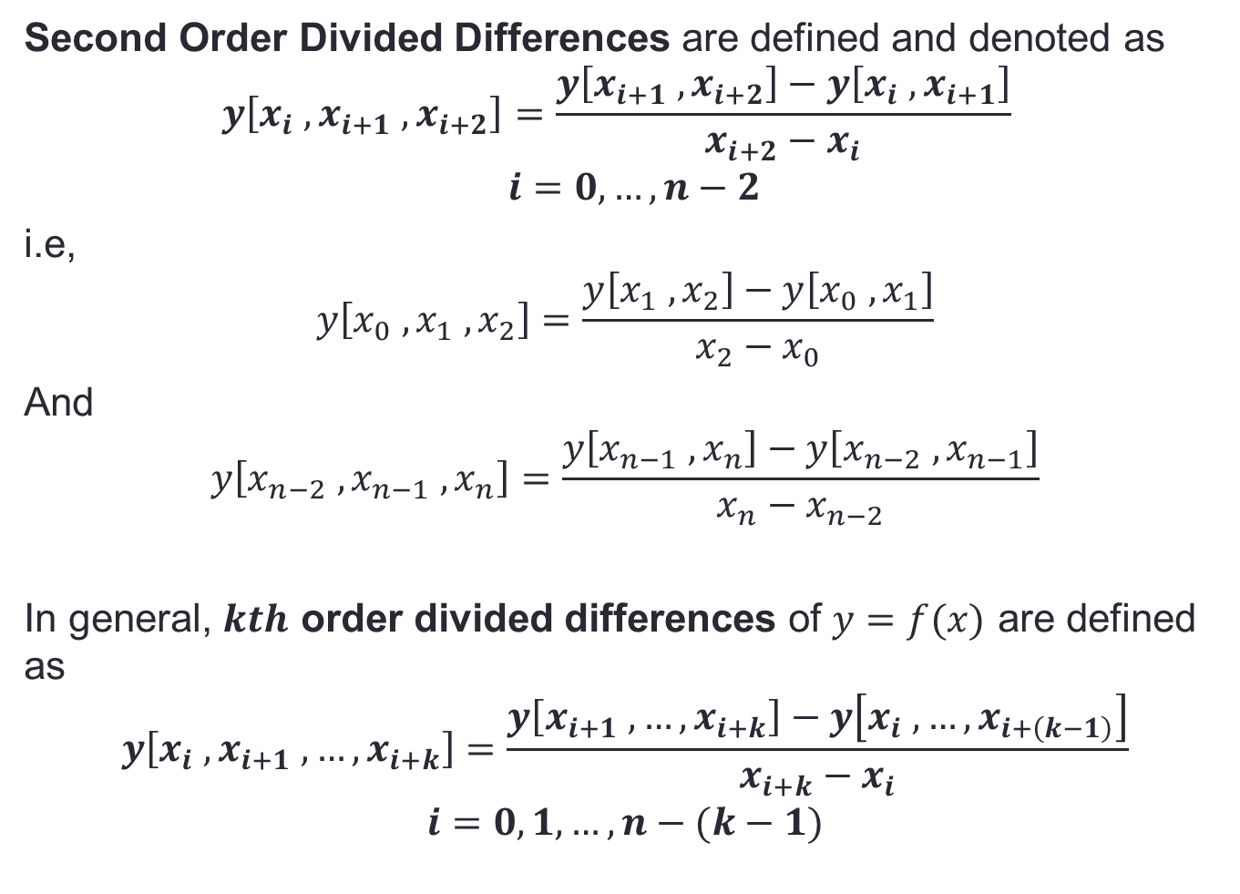
Second Order Divided Differences are defined and denoted as
$$y\left[x_{i} ,x_{i+1} ,x_{i+2}\right]=\frac{y\left[x_{i+1} ,x_{i+2}\right]−y\left[x_{i} ,x_{i+1}\right]}{x_{i+2}−x_{i}}$$
$$i=0,…,n−2$$
i.e,
$$y\left[x_{0} ,x_{1} ,x_{2}\right]=\frac{y\left[x_{1} ,x_{2}\right]−y\left[x_{0} ,x_{1}\right]}{x_{2}−x_{0}}$$
And
$$y\left[x_{n−2} ,x_{n−1} ,x_{n}\right]=\frac{y\left[x_{n−1} ,x_{n}\right]−y\left[x_{n−2} ,x_{n−1}\right]}{x_{n}−x_{n−2}}$$
In general, $kth$ order divided differences of $y=f(x)$ are defined as
$$y\left[x_{i} ,x_{i+1} ,…,x_{i+k}\right]=\frac{y\left[x_{i+1} ,…,x_{i+k}\right]−y\left[x_{i} ,…,x_{i+\left(k−1\right)}\right]}{x_{i+k}−x_{i}}$$
$$i=0,1,…,n−(k−1)$$

Slide 6
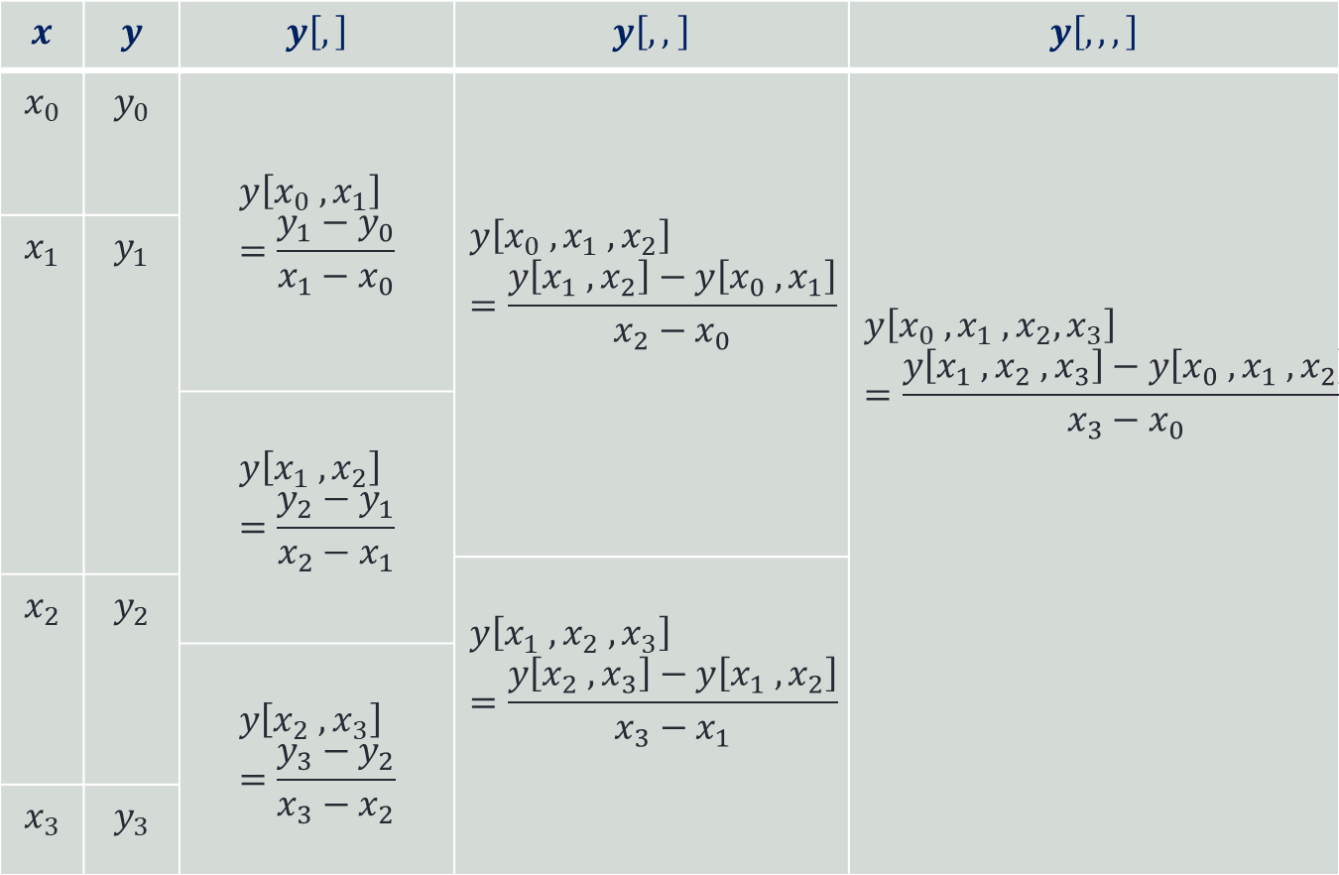
Divided Difference Table
$$x$$ | $$y$$ | $$y\left[,\right]$$ | $$y\left[, , \right]$$ | $$y\left[,,,\right]$$
$$x_{0}$$ | $$y_{0}$$ | $$y\left[x_{0} ,x_{1}\right]=\frac{y_{1}−y_{0}}{x_{1}−x_{0}}$$ | $$y\left[x_{0} ,x_{1} ,x_{2}\right]=\frac{y\left[x_{1} ,x_{2}\right]−y\left[x_{0} ,x_{1}\right]}{x_{2}−x_{0}}$$ | $$y\left[x_{0} ,x_{1} ,x_{2},x_{3}\right]=\frac{y\left[x_{1} ,x_{2} ,x_{3}\right]−y\left[x_{0} ,x_{1} ,x_{2}\right]}{x_{3}−x_{0}}$$
$$x_{1}$$ | $$y_{1}$$
 |  | $$y\left[x_{1} ,x_{2}\right]=\frac{y_{2}−y_{1}}{x_{2}−x_{1}}$$
 |  |  | $$y\left[x_{1} ,x_{2} ,x_{3}\right]=\frac{y\left[x_{2} ,x_{3}\right]−y\left[x_{1} ,x_{2}\right]}{x_{3}−x_{1}}$$
$$x_{2}$$ | $$y_{2}$$
 |  | $$y\left[x_{2} ,x_{3}\right]=\frac{y_{3}−y_{2}}{x_{3}−x_{2}}$$
$$x_{3}$$ | $$y_{3}$$

Slide 7
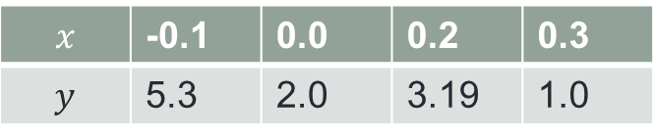
Example 1:
Construct a divided difference table for the following data.
$$x$$ | -0.1 | 0.0 | 0.2 | 0.3
$$y$$ | 5.3 | 2.0 | 3.19 | 1.0

Slide 8
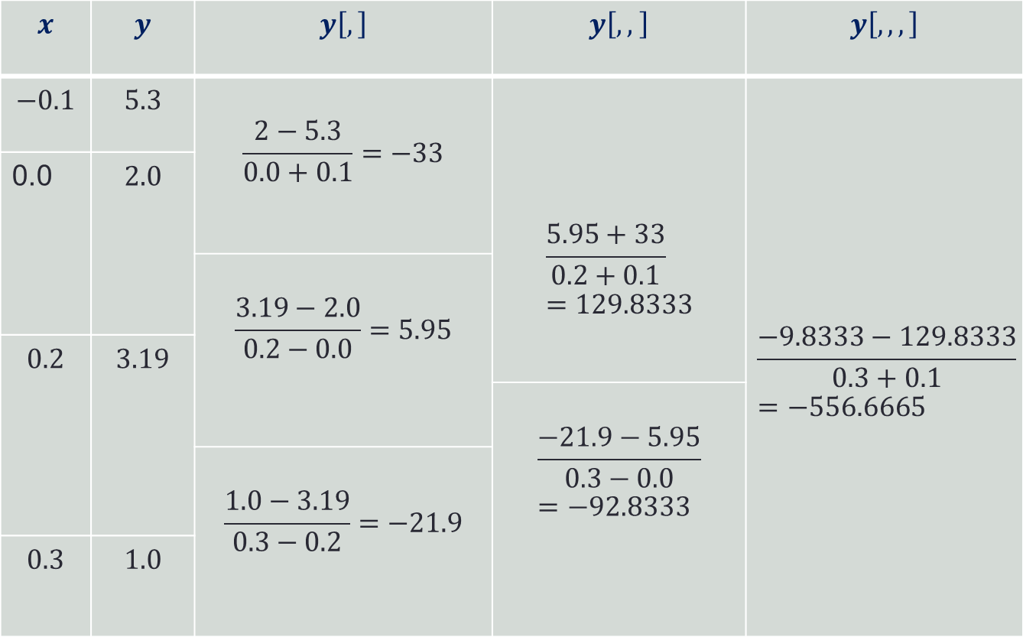
Divided Difference Table
$$x$$ | $$y$$ | $$y\left[,\right]$$ | $$y\left[, , \right]$$ | $$y\left[,,,\right]$$
$$−0.1$$ | $$5.3$$ | $$\frac{2−5.3}{0.0+0.1}=−33$$ | $$\frac{5.95+33}{0.2+0.1}=129.8333$$ | $$\frac{−9.8333−129.8333}{0.3+0.1}=−556.6665$$
0.0 | $$2.0$$
 |  | $$\frac{3.19−2.0}{0.2−0.0}=5.95$$
$$0.2$$ | $$3.19$$
 |  |  | $$\frac{−21.9−5.95}{0.3−0.0}=−92.8333$$
 |  | $$\frac{1.0−3.19}{0.3−0.2}=−21.9$$
$$0.3$$ | $$1.0$$

Slide 9
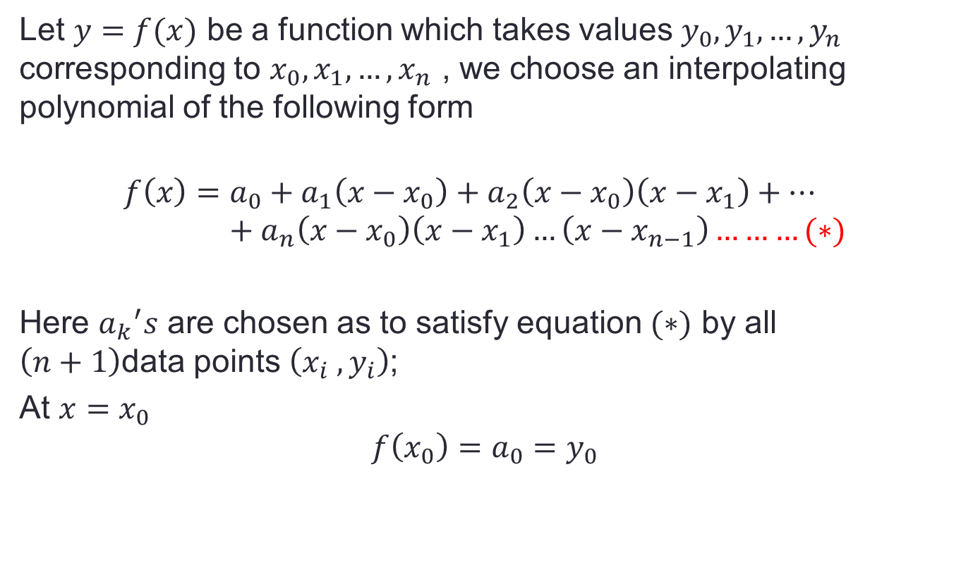
Newton’s Divided Difference Interpolation Formula
Let $y=f(x)$ be a function which takes values $y_{0},y_{1}, …,y_{n}$ corresponding to $x_{0},x_{1}, …,x_{n}$ , we choose an interpolating polynomial of the following form
$$f\left(x\right)=a_{0}+a_{1}\left(x−x_{0}\right)+a_{2}\left(x−x_{0}\right)\left(x−x_{1}\right)+…+a_{n}\left(x−x_{0}\right)\left(x−x_{1}\right)…\left(x−x_{n−1}\right)………(∗)$$
Here ${a_{k}}^{′}s$ are chosen as to satisfy equation $(∗)$ by all $\left(n+1\right)$data points $\left(x_{i} ,y_{i}\right)$;
At $x=x_{0}$
$$f\left(x_{0}\right)=a_{0}=y_{0}$$

Slide 10
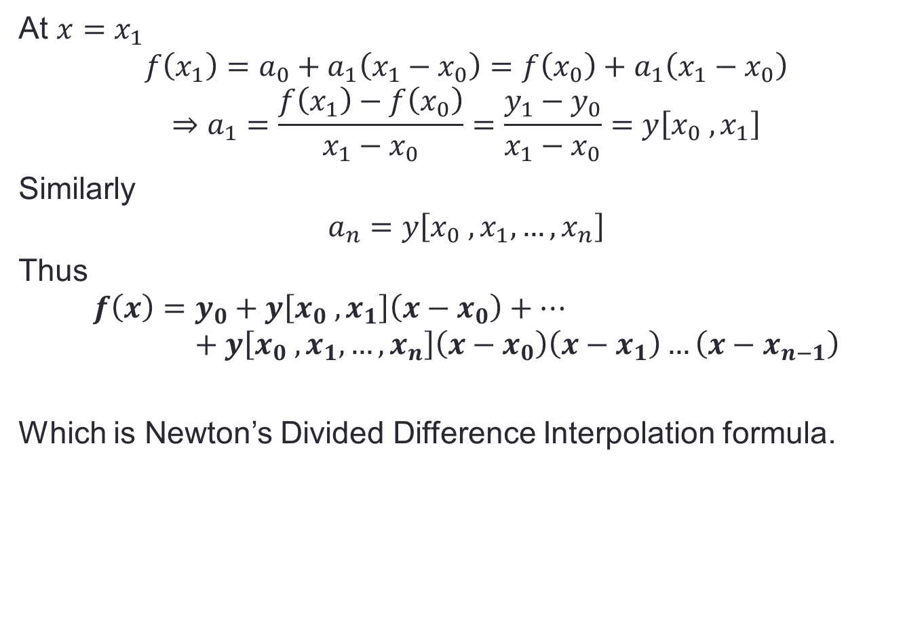
At $x=x_{1}$
$$f\left(x_{1}\right)=a_{0}+a_{1}\left(x_{1}−x_{0}\right)=f\left(x_{0}\right)+a_{1}\left(x_{1}−x_{0}\right)$$
$$⇒a_{1}=\frac{f\left(x_{1}\right)−f\left(x_{0}\right)}{x_{1}−x_{0}}=\frac{y_{1}−y_{0}}{x_{1}−x_{0}}=y\left[x_{0} ,x_{1}\right]$$
Similarly
$$a_{n}=y\left[x_{0} ,x_{1},…,x_{n}\right]$$
Thus
$$f\left(x\right)=y_{0}+y\left[x_{0} ,x_{1}\right]\left(x−x_{0}\right)+…+y\left[x_{0} ,x_{1},…,x_{n}\right]\left(x−x_{0}\right)\left(x−x_{1}\right)…\left(x−x_{n−1}\right)$$
Which is Newton’s Divided Difference Interpolation formula.

Slide 11
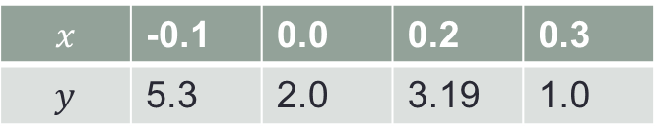

Example 2
Using Newton’s Divided Difference formula, construct polynomials of degree (i) one (ii) two and (iii) three for the following data. Also interpolate value of $y$ for $x=0.1$ in each case.
$$x$$ | -0.1 | 0.0 | 0.2 | 0.3
$$y$$ | 5.3 | 2.0 | 3.19 | 1.0

Slide 12
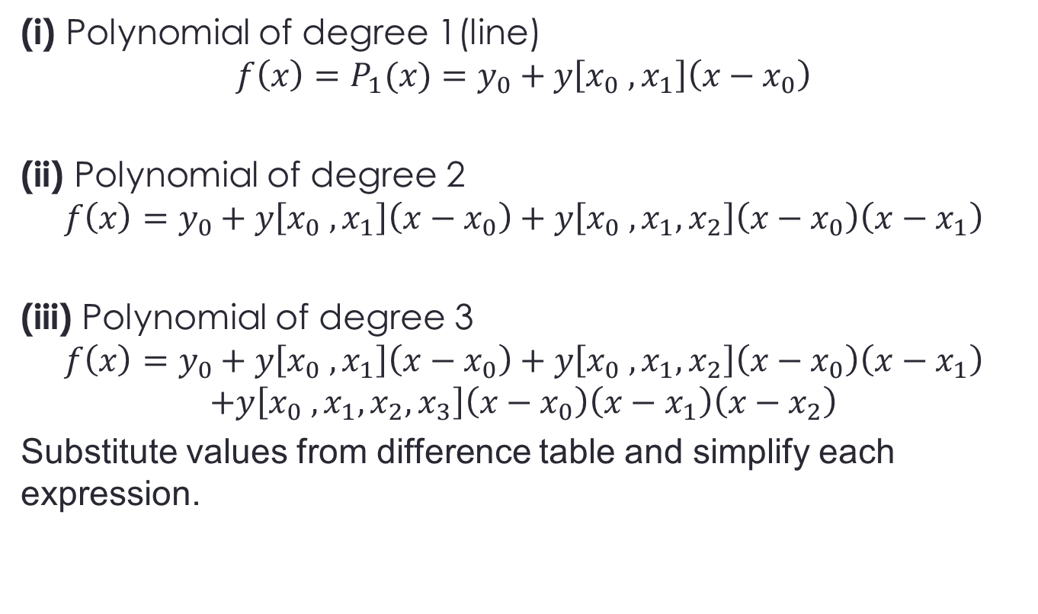
Solution
(i) Polynomial of degree 1(line)
$$f\left(x\right)=P_{1}(x)=y_{0}+y\left[x_{0} ,x_{1}\right]\left(x−x_{0}\right)$$
(ii) Polynomial of degree 2
$$f\left(x\right)=y_{0}+y\left[x_{0} ,x_{1}\right]\left(x−x_{0}\right)+y\left[x_{0} ,x_{1},x_{2}\right]\left(x−x_{0}\right)\left(x−x_{1}\right)$$
(iii) Polynomial of degree 3
$$f\left(x\right)=y_{0}+y\left[x_{0} ,x_{1}\right]\left(x−x_{0}\right)+y\left[x_{0} ,x_{1},x_{2}\right]\left(x−x_{0}\right)\left(x−x_{1}\right)$$
$$+y\left[x_{0} ,x_{1},x_{2},x_{3}\right]\left(x−x_{0}\right)\left(x−x_{1}\right)\left(x−x_{2}\right)$$
Substitute values from difference table and simplify each expression.

Slide 13
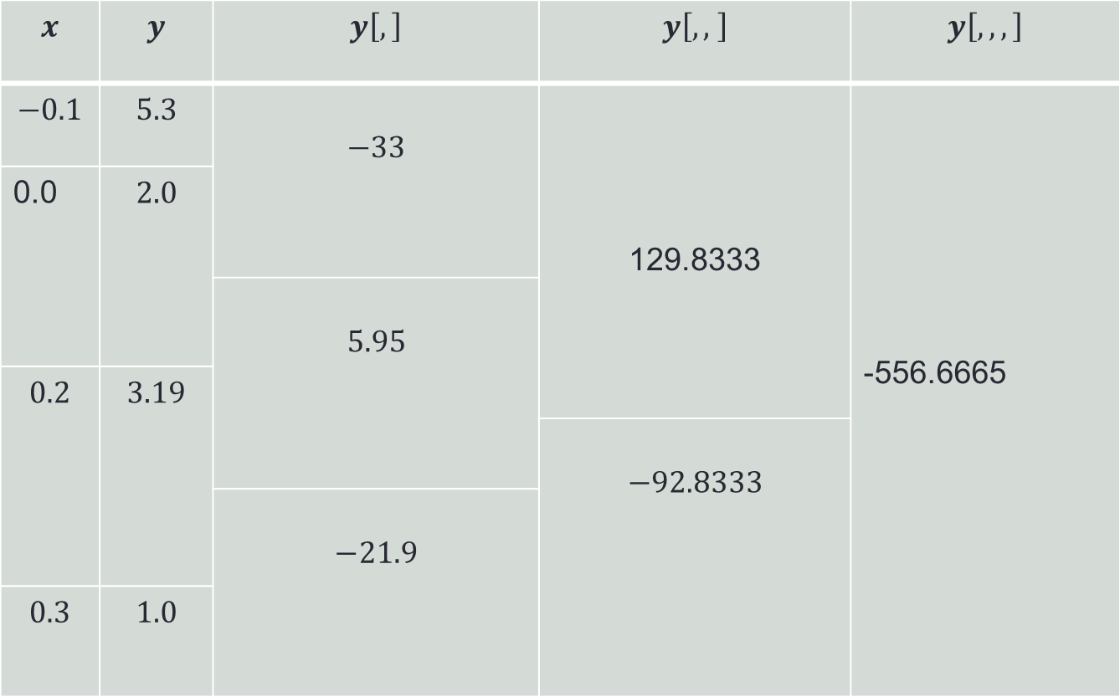
Divided Difference Table
$$x$$ | $$y$$ | $$y\left[,\right]$$ | $$y\left[, , \right]$$ | $$y\left[,,,\right]$$
$$−0.1$$ | $$5.3$$ | $$−33$$ | 129.8333 | -556.6665
0.0 | $$2.0$$
 |  | $$5.95$$
$$0.2$$ | $$3.19$$
 |  |  | $$−92.8333$$
 |  | $$−21.9$$
$$0.3$$ | $$1.0$$

